Slide 2
Overview
Iterative combinational circuits
Binary adders
  Half and full adders
  Ripple carry and carry lookahead adders
Binary subtraction
Binary adder-subtractors
  Signed binary numbers
  Signed binary addition and subtraction
  Overflow
Binary multiplication
Other arithmetic functions

Slide 3
Iterative Combinational Circuits
Arithmetic functions
  Operate on binary vectors
  Use the same subfunction in each bit position
Can design functional block for subfunction and repeat to obtain functional block for overall function
Cell - subfunction block
Iterative array - a array of interconnected cells
An iterative array can be in a single dimension (1D) or multiple dimensions

Slide 4
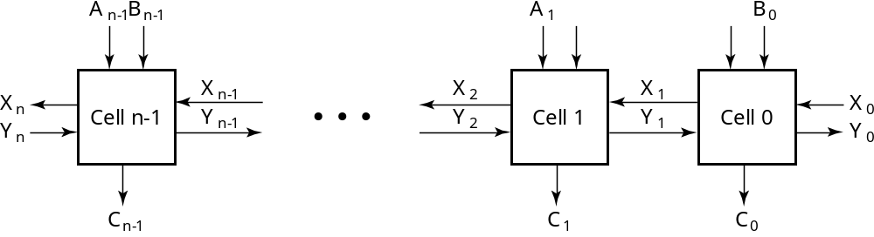
Block Diagram of a 1D Iterative Array
Example: n = 32
  Number of inputs = ?
  Truth table rows = ?
  Equations with up to ? input variables
  Equations with huge number of terms
  Design impractical!
Iterative array takes advantage of the regularity to make design feasible
Notes:
Number of Inputs = 66
Truth Table Rows = 2⁶⁶
Equations with up to 66 variables

Slide 5
Functional Blocks: Addition
Binary addition used frequently
Addition Development:
  Half-Adder (HA), a 2-input bit-wise addition functional block,
  Full-Adder (FA), a 3-input bit-wise addition functional block,
  Ripple Carry Adder, an iterative array to perform binary addition, and
  Carry-Look-Ahead Adder (CLA), a hierarchical structure to improve performance.

Slide 6
Functional Block: Half-Adder
A 2-input, 1-bit width binary adder that performs the following computations:
A half adder adds two bits to produce a two-bit sum
The sum is expressed as a sum bit , S and a carry bit, C
The half adder can be specified as a truth table for S and C ⇒
X
0
0
1
1
+ Y
+ 0
+ 1
+ 0
+ 1
C S
0 0
0 1
0 1
1 0
X
Y
C
S
0
0
0
0
0
1
0
1
1
0
0
1
1
1
1
0

Slide 7
Logic Simplification: Half-Adder
The K-Map for S, C is:
This is a pretty trivial map!
By inspection:
and
These equations lead to several implementations.
S
Y
C
Y
1
0
1
0
1
X
1
X
1
S
=
X
⋅
Y
+
X
⋅
Y
=
X
⊕
Y
2
3
2
3
S
=
(
X
+
Y
)
⋅
(
X
+
Y
)
C
=
X
⋅
Y
C
=
(
(
X
⋅
Y
)
)

Slide 8
Five Implementations: Half-Adder
We can derive following sets of equations for a half-adder:
(a), (b), and (e) are SOP, POS, and XOR implementations for S.
In (c), the C function is used as a term in the AND-NOR implementation of S, and in (d), the function is used in a POS term for S.
(
a
)
S
=
X
⋅
Y
+
X
⋅
Y
(
d
)
S
=
(
X
+
Y
)
⋅
C
C
=
X
⋅
Y
C
=
(
X
+
Y
)
(
b
)
S
=
(
X
+
Y
)
⋅
(
X
+
Y
)
(
e
)
S
=
X
⊕
Y
C
=
X
⋅
Y
C
=
X
⋅
Y
(
c
)
S
=
(
C
+
X
⋅
Y
)
C
=
X
⋅
Y
C

Slide 9
Implementations: Half-Adder
The most common half adder implementation is: (e)
A NAND only implementation is:
X
S
Y
S
=
X
⊕
Y
C
C
=
X
⋅
Y
C
X
S
=
(
X
+
Y
)
⋅
C
C
=
(
(
X
⋅
Y
)
)
S
Y

Slide 10
Functional Block: Full-Adder
A full adder is similar to a half adder, but includes a carry-in bit from lower stages. Like the half-adder, it computes a sum bit, S and a carry bit, C.
  For a carry-in (Z) of 0, it is the same as the half-adder:
  For a carry- in
  (Z) of 1:
Z
0
0
0
0
X
0
0
1
1
+ Y
+ 0
+ 1
+ 0
+ 1
C S
0
0
0 1
0 1
1 0
Z
1
1
1
1
X
0
0
1
1
+ Y
+ 0
+ 1
+ 0
+ 1
C S
0 1
1 0
1 0
1
1

Slide 11
Logic Optimization: Full-Adder
Full-Adder Truth Table:
Full-Adder K-Map:
X
Y
Z
C
S
0
0
0
0
0
0
0
1
0
1
0
1
0
0
1
0
1
1
1
0
1
0
0
0
1
1
0
1
1
0
1
1
0
1
0
1
1
1
1
1
S
Y
C
Y
1
1
1
0
1
3
2
0
1
3
2
X
1
1
X
1
1
1
4
5
7
6
4
5
7
6
Z
Z

Slide 12
Equations: Full-Adder
From the K-Map, we get:
The S function is the three-bit XOR function (Odd Function):
The Carry bit C is 1 if both X and Y are 1 (the sum is 2), or if the sum is 1 and a carry-in (Z) occurs. Thus C can be re-written as:
The term X·Y is carry generate.
The term X⊕Y is carry propagate.
S
=
X
Y
Z
+
X
Y
Z
+
X
Y
Z
+
X
Y
Z
C
=
X
Y
+
X
Z
+
Y
Z
S
=
X
⊕
Y
⊕
Z
C
=
X
Y
+
(
X
⊕
Y
)
Z

Slide 13
Implementation: Full Adder
Ai
Bi
Full Adder Schematic
Here X, Y, and Z, and C
(from the previous pages)
are A, B, C_{i} and C_{o},
respectively. Also,
G = generate and
P = propagate.
Note: This is really a combination
of a 3-bit odd function (for S)) and
Carry logic (for C_{o}):
(G = Generate) OR (P =Propagate AND C_{i} = Carry In)
Co = G + P · Ci
Gi
Pi
Ci
Ci+1
Si

Slide 14
Binary Adders
To add multiple operands, we “bundle” logical signals together into vectors and use functional blocks that operate on the vectors
Example: 4-bit ripple carry
adder: Adds input vectors A(3:0) and B(3:0) to get
a sum vector S(3:0)
Note: carry out of cell i
becomes carry in of cell
i + 1
Description
Subscript
Name
3 2 1 0
Carry In
0 1 1 0
Ci
Augend
1 0 1 1
Ai
Addend
0 0 1 1
Bi
Sum
1 1 1 0
Si
Carry out
0 0 1 1
Ci+1

Slide 15
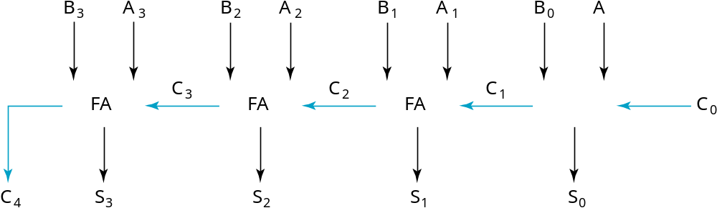
4-bit Ripple-Carry Binary Adder
A four-bit Ripple Carry Adder made from four 1-bit Full Adders:

Slide 16
Signed Integers
Positive numbers and zero can be represented by unsigned n-digit, radix r numbers. We need a representation for negative numbers.
To represent a sign (+ or –) we need exactly one more bit of information (1 binary digit gives 2¹ = 2 elements which is exactly what is needed).
Since computers use binary numbers, by convention, the most significant bit is interpreted as a sign bit:
s a_{n–2} … a₂a₁a₀
where:
s = 0 for Positive numbers
s = 1 for Negative numbers
and a_{i} = 0 or 1 represent the magnitude in some form.

Slide 17
Complements
Two complements:
  Diminished Radix Complement of N
    (r − 1)’s complement for radix r
    1’s complement for radix 2
    Defined as (r^{n} − 1) − Ν
  Radix Complement
    r’s complement for radix r
    2’s complement in binary
    Defined as r^{n} − N
Subtraction is done by adding the complement of the subtrahend
If the result is negative, takes its 2’s complement

Slide 18
Signed-2’s Complement Arithmetic
Addition:
  1. Add the numbers including the sign bits, discarding a carry out of the sign bits.
  2. If the sign bits were the same for both numbers and the sign of the result is different, an overflow has occurred.
  3. The sign of the result is computed in step 1.
Subtraction:
  Form the complement of the number you are subtracting and follow the rules for addition.

Slide 19
Signed 2’s Complement Examples
Example 1: 1101
+ 0011
Example 2: 1101
− 0011
Notes:
Example 1: Result is 0000. The carry out of the MSB is discarded.
Example 2: Complement 0011 to 1101 and add. Result is 1010. The carry out of the MSB is discarded.

Slide 20
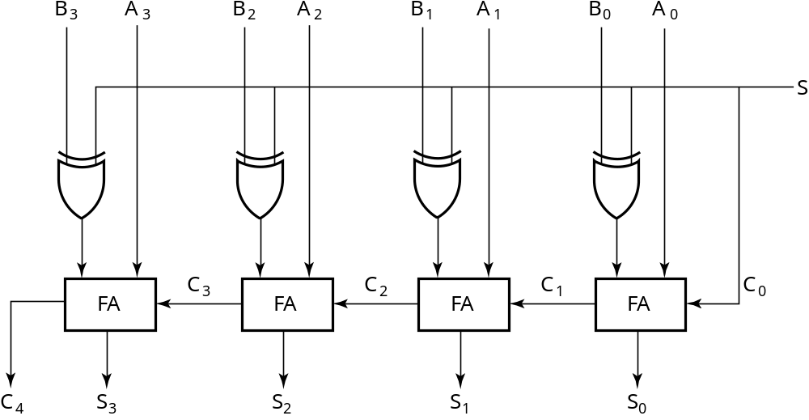
2’s Complement Adder/Subtractor
Subtraction can be done by addition of the 2's Complement.
1. Complement each bit (1's Complement.)
2. Add 1 to the result.
The circuit shown computes A + B and A – B:
For S = 1, subtract,
the 2’s complement
of B is formed by using
XORs to form the 1’s
comp and adding the 1
applied to C₀.
For S = 0, add, B is
passed through
unchanged

Slide 21
Overflow Detection
Overflow occurs if n + 1 bits are required to contain the result from an n-bit addition or subtraction
Overflow can occur for:
  Addition of two operands with the same sign
  Subtraction of operands with different signs
Detection can be performed by examining the result signs which should match the signs of the top operand
Simplest way to implement overflow V = C_{n} + C_{n − 1}

Slide 22
Carry Propagation
What is the total delay of 4-bit ripple carry adder?
  τ_{FA}: delay of a one full adder
  Serial connected 4 full adders are used.
  Total delay: 4τ_{FA}.
ai
Pi
bi
Si
Gi
Ci+1
Ci
4τFA ≈ 8τXOR

Slide 23
Faster Adders
The carry propagation technique is a limiting factor in the speed with which two numbers are added.
Two alternatives
  use faster gates with reduced delays
  Increase the circuit complexity (i.e. put more gates) in such a way that the carry delay time is reduced.
An example for the latter type of solution is carry lookahead adders

Slide 24
Carry Lookahead Adders
Sum and carry can be expressed in terms of P_{i} and G_{i}:
  S_{i} = P_{i} ⊕ C_{i}
  C_{i+1} = G_{i} + P_{i}C_{i}
Why the names (carry propagate and generate)?
  If G_{i} = 1 (both a_{i} = b_{i} = 1), then a “new” carry is generated
  If P_{i} = 1 (either a_{i} = 1 or b_{i} = 1), then a carry coming from the previous lower bit position is propagated to the next higher bit position

Slide 25
4-bit Carry Lookahead Adder
We can use the carry propagate and carry generate signals to compute carry bits used in addition operation
  C₀ = input
  C₁ = G₀ + P₀C₀
  C₂ = G₁ + P₁C₁
  = G₁ + P₁(G₀ + P₀C₀) = G₁ + P₁G₀ + P₁P₀C₀
  C₃ = G₂ + P₂C₂ = G₂ + P₂(G₁ + P₁G₀ + P₁P₀C₀)
  = G₂ + P₂G₁ + P₂P₁G₀ + P₂P₁P₀C₀
  P₀ = a₀ ⊕ b₀ and G₀ = a₀b₀
  P₁ = a₁ ⊕ b₁ and G₁ = a₁b₁
  P₂ = a₂ ⊕ b₂ and G₂ = a₂b₂
  P₃ = a₃ ⊕ b₃ and G₃ = a₃b₃

Slide 26
4-bit Carry Lookahead Circuit 1/3
C1 = G0 + P0C0
C2 = G1 + P1G0 + P1P0C0
C3 = G2 + P2G1 + P2P1G0 + P2P1P0C0
C3
P2
G2
C2
P1
G1
P0
C1
G0
C0

Slide 27
4-bit Carry Lookahead Circuit 2/3
All three carries (C₁, C₂, C₃) can be realized as two-level implementation (i.e. AND-OR)
C₃ does not have to wait for C₂ and C₁ to propagate
C₃ has its own circuit
The propagations happen concurrently

Slide 28
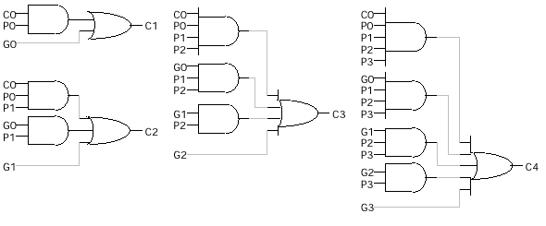
4-bit Carry Lookahead Circuit 3/3
Two levels of logic

Slide 29
4-bit Carry Lookahead Adder
a3
Carry
Lookahead
circuit
C4
b3
P3
C4
G3
P3
a2
C3
S3
b2
P2
G2
P2
S2
C2
a1
b1
P1
G2
P1
S1
C1
a0
b0
P0
G0
P0
C0
S0
C0
C0

Slide 30
Hybrid Approach for 16-bit Adder
a15
a12
b15
b12
a11
a8
b11
b8
a7
a4
b7
b4
a3
a0
b3
b0
…
…
…
…
…
…
…
…
4-bit CLA
4-bit CLA
4-bit CLA
4-bit CLA
c16
c12
c8
c4
…
…
…
…
s15
s12
s11
s8
s7
s4
s3
s0

Slide 31
Binary Multipliers
Two-bit multiplier
 |  | y1 | y0 |  | Y
 | × | x1 | x0 |  | X
 |  | x0 y1 | x0 y0
+ | x1 y1 | x1 y0
z3 | z2 | z1 | z0 |  | Z
y1
y0
x0
y1
y0
x1
HA
HA
z3
z2
z1
z0

Slide 32
(3x4)-bit Multiplier: Method
 |  |  | y3 | y2 | y1 | y0 | Y
 |  | × |  | x2 | x1 | x0 | X
 |  |  | x0 y3 | x0 y2 | x0 y1 | x0 y0
 |  | x1 y3 | x1 y2 | x1 y1 | x1 y0
+ | x2 y3 | x2 y2 | x2 y1 | x2 y0
z6 | z5 | z4 | z3 | z2 | z1 | z0

Slide 33
4-bit Multiplier: Circuit
x0
y3
y2
y1
y0
x1
y3
y2
y1
y0
0
Sout
4-bit Adder
y3
y2
y1
y0
x2
Cout
4-bit Adder
Sout
Cout
z6
z5
z4
z3
z2
z1
z0

Slide 34
mxn-bit Multipliers
Generalization:
multiplier: m-bit integer
multiplicand: n-bit integer
m×n AND gates
(m-1) adders
  each adder is n-bit

Slide 35
Multiplication/Division by 2^{n}
(a) Multiplication
by 100
  Shift left by 2
(b) Division
by 100
  Shift right by 2
  Remainder
  preserved
B
3
B
2
B
1
B
0
0
0
C
5
C
4
C
3
C
2
C
1
C
0
(a)
B
3
B
2
B
1
B
0
0
0
C
3
C
2
C
1
C
0
C
-1
C
-2
(b)

Slide 36
Magnitude Comparator
Comparison of two integers: A and B.
  A > B ➔ (1, 0, 0) = (x, y, z)
  A = B ➔ (0, 1, 0) = (x, y, z)
  A < B ➔ (0, 0, 1) = (x, y, z)
Example: 4-bit magnitude comparator
  A = (a₃, a₂, a₁, a₀) and B = (b₃, b₂, b₁, b₀)
  (A = B) case
    they are equal if and only if a_{i} = b_{i} 0 ≤ i ≤ 3
    t_{i} = (a_{i} ⊕ b_{i})′ 0 ≤ i ≤ 3
    y = (A=B) = t₃ t₂ t₁ t₀

Slide 37
4-bit Magnitude Comparator
(A > B) and (A < B) cases
  We compare the most significant bits of A and B first.
    if (a₃ = 1 and b₃ = 0) ➔ A > B
    else if (a₃ = 0 and b₃ = 1) ➔ A < B
    else (i.e. a₃ = b₃) compare a₂ and b₂.
x = (A>B) = a3b3′+t3a2b2′+t3t2a1b1′+t3t2t1a0b0′
z = (A<B) = a3′b3+t3a2′b2+t3t2a1′b1+t3t2t1a0′b0
y = (A=B) = t3t2t1t0

Slide 38
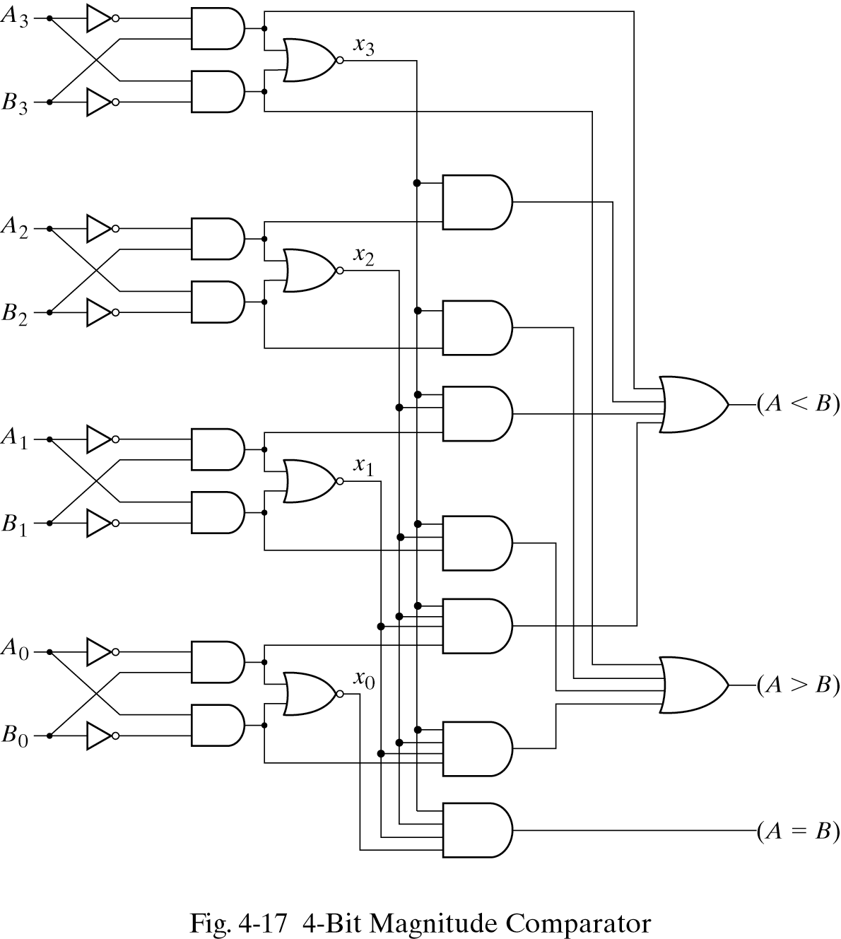
4-bit Magnitude Comparator: Circuit

